Slide 1
BREAK FAST DELIVERY APP
Foul & Falafel

Slide 2
What app do?
The program linked those who want breakfast (foul and falafel) with the man who prepares the breakfast
enable him to enjoy his food with the least amount of trouble and money and with the maximum amount of comfort, whether it is at home, university, work, school, or anywhere else.

Slide 3
Problems app solve
Breakfast
crowding
harassment
unemployment
problems

Slide 4
HOW ?
How will we solve the problem: Through the app, you can order breakfast from anywhere at any time In an easy and simple way

Slide 5
01
02
03
04
Reducing crowds
Reducing harassment
Reducing unemployment
Reducing noise and problems
Benefit
the man who prepares breakfast and the client
the girls who go to buy breakfast
men and children who will deliver
You can describe the topic of the section here

Slide 6
05
06
07
Save time and effort
Digital Transformation
The link between culture and technology
Benefit
customer
Country
state and tourism

Slide 7
Our Values
Convenience and Time-Saving: With busy lifestyles and increasing reliance on technology
Accessibility and Availability
Seamless Ordering Process: Traditional phone-based food ordering can be cumbersome, with potential issues such as miscommunication, busy phone lines
Enhanced Tracking and Transparency
Feedback and Reviews: Customers often rely on reviews and ratings to make informed decisions about where to order food.
MyDelivery

Slide 8
audience
Restaurant owners (foul and falafel)School and university students, administrators, and everyone who wants a bean and falafel breakfast Children from the age of 12 to the age of 18 to work on delivery on the wheel

Slide 9
audience Satisfaction
Whoever takes the user service:
Whoever provides the service is the owner:
Those who deliver the service Delivery:
We save him time, effort, problems and money
We reduce the pressure, effort and time on him, and we increase the income and reduce the employment
We provide a simple, fast and income job

Slide 10
Services we will provide:
user registration
restaurant listings
menu browsing
order placement
payment options
order tracking

Slide 11
What sets you apart from competitors?
user experience
reviews and ratings
order tracking
more specific
Ease of use and flexibility
To choose by comments and rating
order tracking to ensure connection and security
we do not deliver any food, we specialize in breakfast

Slide 12
Timeline
1 Week
2 Weeks
1 month
3 Weeks
design
testing
planning
implementation

Slide 13

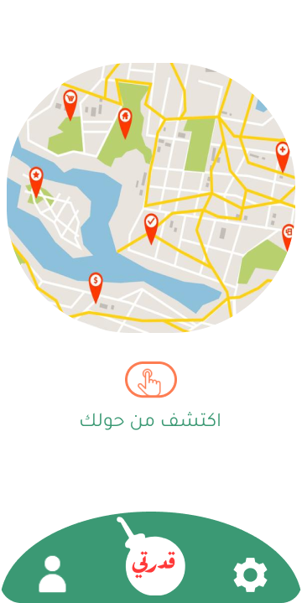
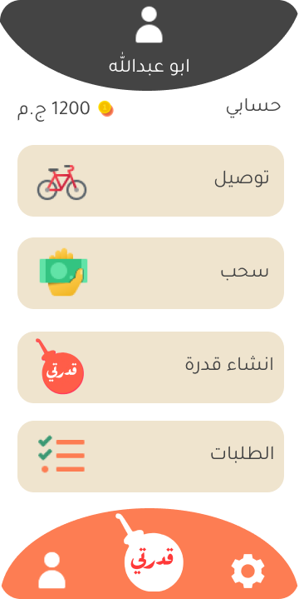
Demo

Slide 14
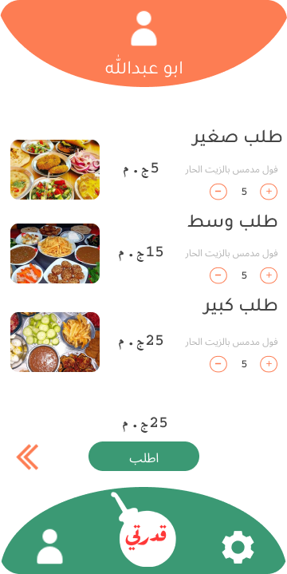
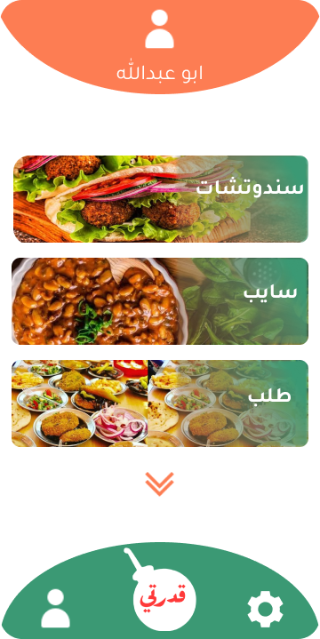
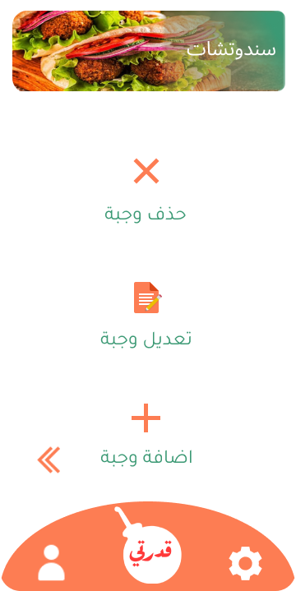
Demo

Slide 15






Technologies
Flutter Figma Android studio
Firebase Dart Visual Studio Code

Slide 16
Our Team
Reham
Adham
Soha
System Analysist
Mobile Developer
Rowan
Naira
Database designer
Tester
Ziad
Designer, System Analysist
System Analysist

Slide 17
Thanks!

